Slide 1
UNIT 3 - TRANSMISSION MEDIA
COMPUTER NETWORKS I
CODE: CS 8137
FACILITATOR: FRANK
EMAIL: frankibrahim25@gmail.com

Slide 2
We definitely need transmission media to conduct signals from the source to the destination. However, the media can be wired or wireless.
This unit is divided into three sections:
The first section introduces the transmission media and defines its position in the Internet model.
The second section discusses guided media. The first part describes twisted-pair cables and their characteristics and applications.
The third section discusses unguided media. The first part describes radio waves and their characteristics and applications.

Slide 3
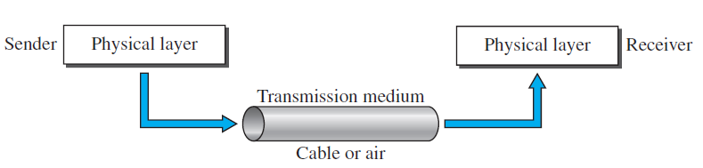
Introduction
Transmission media are actually located below the physical layer and are directly controlled by the physical layer. We could say that transmission media belong to layer zero.
Transmission medium and physical layer
No network can function without a transmission medium because there would be no connection between the transmitting elements.

Slide 4
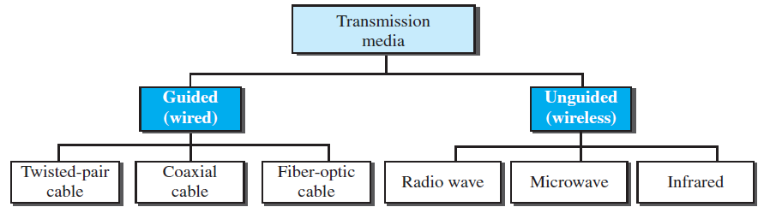
A transmission medium can be broadly defined as anything that can carry information from a source to a destination.
For example, the transmission medium for two people having a dinner conversation is the air.
In telecommunications, transmission media can be divided into two broad categories: guided media and unguided media.

Slide 5
Guided transmission media
For guided transmission media, the transmission capacity, in terms of either data rate or bandwidth, depends critically on the distance and on whether the medium is point-to-point or multipoint.
The three guided media commonly used for data transmission are twisted-pair cable, coaxial cable, and fiber-optic cable.
Twisted-pair and coaxial cable use metallic (copper) conductors that accept and transport signals in the form of electric current. Optical fiber is a cable that accepts and transports signals in the form of light.

Slide 6
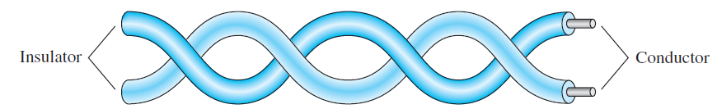
Twisted-Pair Cable
A twisted pair consists of two insulated copper wires arranged in a regular spiral pattern.
A twisted pair consists of two conductors (normally copper), each with its own plastic insulation, twisted together.
One of the wires is used to carry signals to the receiver, and the other is used only as a ground reference.

Slide 7
Unshielded and Shielded Twisted-Pair Cable
Twisted pair comes in two varieties: unshielded and shielded.
The most common twisted-pair cable used in communications is referred to as unshielded twisted-pair (UTP).
Unshielded twisted pair is subject to external electromagnetic interference, including interference from nearby twisted pair and from noise generated in the environment.
A way to improve the characteristics of this medium is to shield the twisted pair with a metallic braid or sheathing that reduces interference.

Slide 8
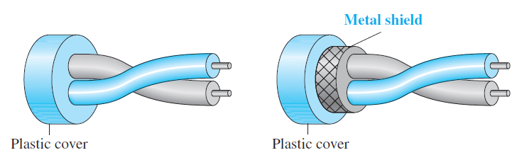
IBM has also produced a version of twisted-pair cable for its use, called shielded twisted-pair (STP).
STP cable has a metal foil or braidedmesh covering that encases each pair of insulated conductors.
Although metal casing improves the quality of cable by preventing the penetration of noise or crosstalk, it is bulkier and more expensive.

Slide 9
Categories
The Electronic Industries Association (EIA) has developed standards to classify unshielded twisted-pair cable into seven categories. The most commonly used UTP cabling are:
Category 3: UTP cables and associated connecting hardware whose transmission characteristics are specified up to 16 MHz
Category 4: UTP cables and associated connecting hardware whose transmission characteristics are specified up to 20 MHz
Category 5: UTP cables and associated connecting hardware whose transmission characteristics are specified up to 100 MHz
Of these, it is Category 3 and Category 5 cable that have received the most attention for LAN applications.

Slide 10
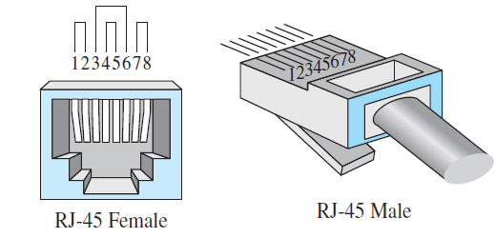
Connectors
The most common UTP connector is RJ45 (RJ stands for registered jack), as shown in Figure below.
The RJ45 is a keyed connector, meaning the connector can be inserted in only one way.
UTP Connector
Twisted-pair cables are used in telephone lines to provide voice and data channels.

Slide 11
Local-area networks, such as 10Base-T and 100Base-T, also use twisted-pair cables.
Coaxial Cable
Coaxial cable are dual-conductor cables with a shared inner conductor in the core of the cable protected by an insulation layer and the outer conductor surrounding the insulation.
These cables are called coaxial because they share the inner conductor.
The outer metallic wrapping serves both as a shield against noise and as the second conductor, which completes the circuit.
This outer conductor is also enclosed in an insulating sheath, and the whole cable is protected by a plastic cover.

Slide 12
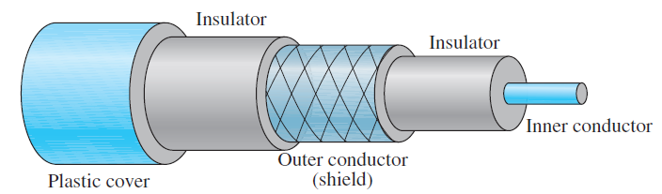
Coaxial Cable Connectors
To connect coaxial cable to devices, we need coaxial connectors. The most common type of connector used today is the Bayonet Neill-Concelman (BNC) connector.
Figure below shows three popular types of these connectors: the BNC connector, the BNC T connector, and the BNC terminator.

Slide 13
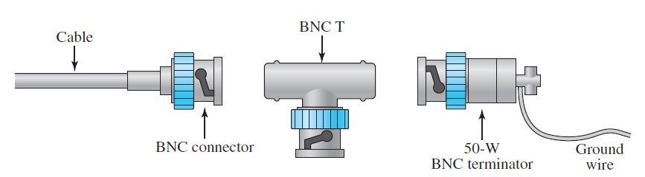
BNC connectors
Application
Coaxial cables are commonly used in television transmissions.
Coaxial cable was widely used in analog telephone networks where a single coaxial network could carry 10,000 voice signals.
Digital telephone networks where a single coaxial cable could carry digital data up to 600 Mbps.

Slide 14
Fiber-Optic Cable
A fiber-optic cable is made of glass or plastic and transmits signals in the form of light.
Light travels in a straight line as long as it is moving through a single uniform substance.
If a ray of light traveling through one substance suddenly enters another substance (of a different density), the ray changes direction.
This is the most ideal cable for data transmission because it can accommodate extremely high bandwidths and has few problems with electromagnetic interference that coaxial cables suffer from.
It can also support cabling for several kilometers.

Slide 15
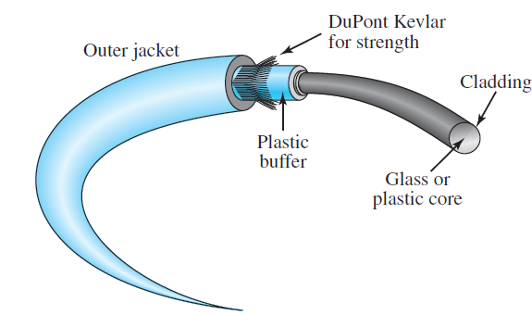
Fiber-Optic Cable Connectors
There are three types of connectors for fiber-optic cables, as shown in Figure below.
The subscriber channel (SC) connector is used for cable TV. It uses a push/pull locking system.
The straight-tip (ST) connector is used for connecting cable to networking devices.

Slide 16
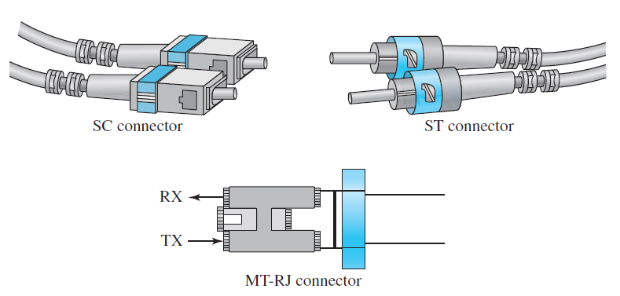
It uses a bayonet locking system and is more reliable than SC.
MT-RJ is a connector that is the same size as RJ45.
Fiber-optic cable connectors

Slide 17
Applications
Fiber-optic cable is often found in backbone networks because its wide bandwidth is cost-effective.
Some cable TV companies use a combination of optical fiber and coaxial cable, thus creating a hybrid network. Optical fiber provides the backbone structure while coaxial cable provides the connection to the user premises.
Local-area networks such as 100Base-FX network (Fast Ethernet) and 1000Base-X also use fiber-optic cable.

Slide 18
Advantages and Disadvantages of Optical Fiber
Advantages
Higher bandwidth. Fiber-optic cable can support dramatically higher bandwidths (and hence data rates) than either twisted-pair or coaxial cable.
Less signal attenuation. Fiber-optic transmission distance is significantly greater than that of other guided media. A signal can run for 50 km without requiring regeneration.
We need repeaters every 5 km for coaxial or twisted-pair cable.
Immunity to electromagnetic interference. Electromagnetic noise cannot affect fiber-optic cables.

Slide 19
Resistance to corrosive materials. Glass is more resistant to corrosive materials than copper.
Light weight. Fiber-optic cables are much lighter than copper cables.
Greater immunity to tapping. Fiber-optic cables are more immune to tapping than copper cables. Copper cables create antenna effects that can easily be tapped.
Disadvantages
Installation and maintenance. Fiber-optic cable is a relatively new technology. Its installation and maintenance require expertise that is not yet available everywhere.

Slide 20
Unidirectional light propagation. Propagation of light is unidirectional. If we need bidirectional communication, two fibers are needed.
Cost. The cable and the interfaces are relatively more expensive than those of other guided media. If the demand for bandwidth is not high, often the use of optical fiber cannot be justified.

Slide 21
Unguided media: wireless
Unguided medium transport electromagnetic waves without using a physical conductor.
This type of communication is often referred to as wireless communication.
Signals are normally broadcast through free space and thus are available to anyone who has a device capable of receiving them.
Unguided signals can travel from the source to the destination in several ways: ground propagation, sky propagation, and line-of-sight propagation.
In ground propagation, radio waves travel through the lowest portion of the atmosphere, hugging the earth.

Slide 22
These low-frequency signals emanate in all directions from the transmitting antenna and follow the curvature of the planet.
Distance depends on the amount of power in the signal: The greater the power, the greater the distance.
In sky propagation, higher-frequency radio waves radiate upward into the ionosphere (the layer of atmosphere where particles exist as ions) where they are reflected back to earth.
This type of transmission allows for greater distances with lower output power.
In line-of-sight propagation, very high-frequency signals are transmitted in straight lines directly from antenna to antenna.

Slide 23
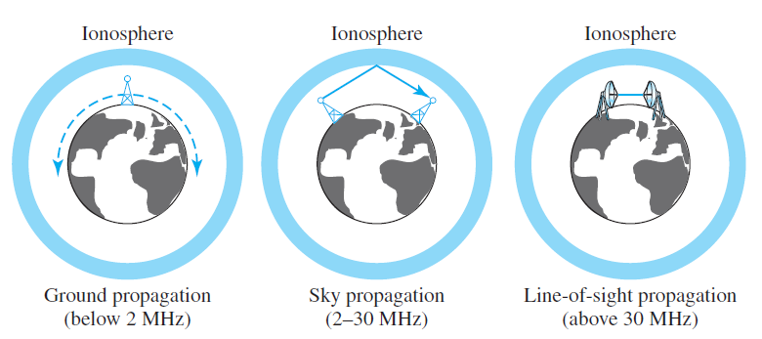
Antennas must be directional, facing each other, and either tall enough or close enough together not to be affected by the curvature of the earth.
Line-of-sight propagation is tricky because radio transmissions cannot be completely focused.

Slide 24
We can divide wireless transmission into three broad groups: radio waves, microwaves, and infrared waves.
Radio Waves
Although there is no clear-cut demarcation between radio waves and microwaves, electromagnetic waves ranging in frequencies between 3 kHz and 1 GHz are normally called radio waves; waves ranging in frequencies between 1 and 300 GHz are called microwaves.
Radio waves, for the most part, are omnidirectional.
When an antenna transmits radio waves, they are propagated in all directions. This means that the sending and receiving antennas do not have to be aligned.

Slide 25
A sending antenna sends waves that can be received by any receiving antenna.
Radio waves, particularly those waves that propagate in the sky mode, can travel long distances. This makes radio waves a good candidate for long-distance broadcasting such as AM radio.
Omnidirectional Antenna
Radio waves use omnidirectional antennas that send out signals in all directions.
Based on the wavelength, strength, and the purpose of transmission, we can have several types of antennas.

Slide 26
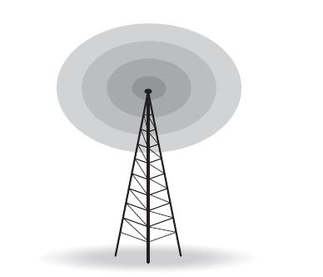
Applications
The omnidirectional characteristics of radio waves make them useful for multicasting, in which there is one sender but many receivers.
AM and FM radio, television, maritime radio, cordless phones, and paging are examples of multicasting.
Omnidirectional antenna

Slide 27
Microwaves
Electromagnetic waves having frequencies between 1 and 300 GHz are called microwaves.
Microwaves are unidirectional. When an antenna transmits microwaves, they can be narrowly focused. This means that the sending and receiving antennas need to be aligned.
A pair of antennas can be aligned without interfering with another pair of aligned antennas.
Unidirectional Antenna: Microwaves need unidirectional antennas that send out signals in one direction.
Two types of antennas are used for microwave communications: the parabolic dish and the horn.

Slide 28
A parabolic dish antenna is based on the geometry of a parabola: Every line parallel to the line of symmetry (line of sight) reflects off the curve at angles such that all the lines intersect in a common point called the focus.
Horn antenna looks like a gigantic scoop. Outgoing transmissions are broadcast up a stem (resembling a handle) and deflected outward in a series of narrow parallel beams by the curved head.
Applications
Microwaves, due to their unidirectional properties, are very useful when unicast (oneto-one) communication is needed between the sender and the receiver.

Slide 29
They are used in cellular phones, satellite networks , and wireless LANs.
Infrared waves, with frequencies from 300 GHz to 400 THz (wavelengths from 1 mm to 770 nm), can be used for short-range communication. Infrared waves, having high frequencies, cannot penetrate walls.
Applications
The infrared band, almost 400 THz, has an excellent potential for data transmission. Such a wide bandwidth can be used to transmit digital data with a very high data rate.

